Slide 1

Financial Dashboard in Streamlit with Python
Zhaksybek Dilda
November 15, 2021

Slide 2
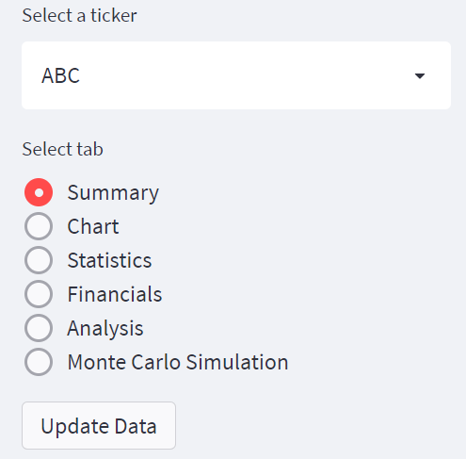
Sidebar
Side bar offers 3 functions :
Selection of a stock ticker. Selected ticker is then used to display data for all tabs of the report.
Selection of a report tab.
Button to update/refresh data for a whole report.

Slide 3
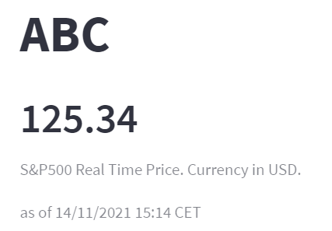
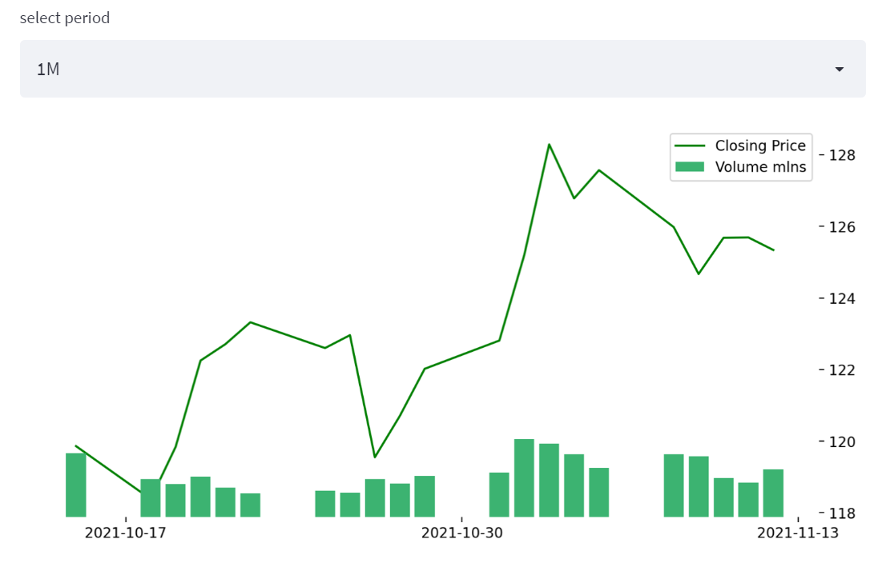
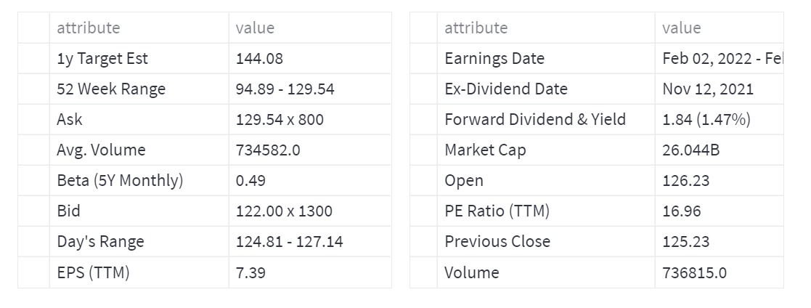
Tab1: Chart
1
This tab presents general info for the selected stock.
Ticker name, live price, date and time for which data is shown.
Pandas Line chart to show stock closing price and volume (scaled down) for the selected period from 1M to MAX.
Displaying quote table by get_guote_table function.
2
3

Slide 4
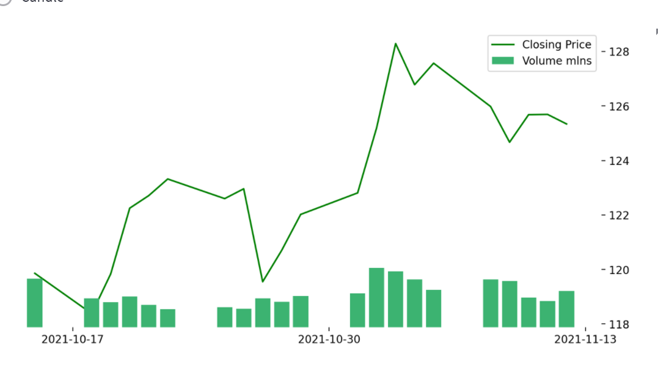
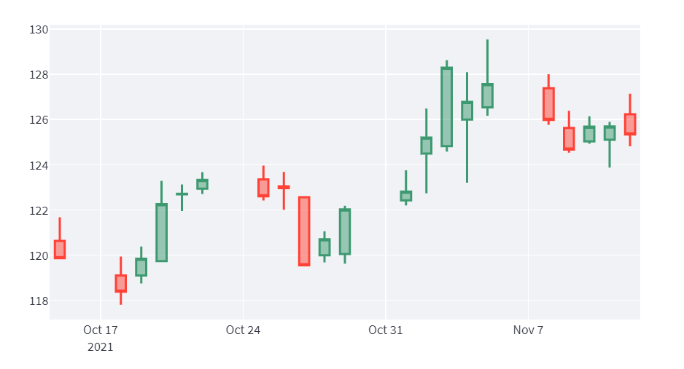
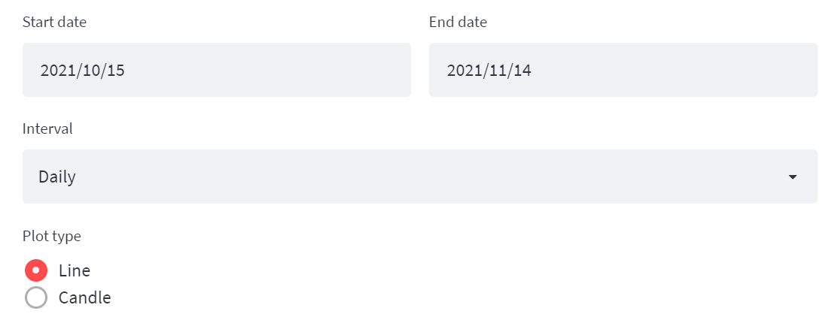
Tab2: Chart
2
Selection pane for date, time interval of data visualizations for the chart and selection of plot type: Line or Candle.
Line Chart for selected ticker for close price and volume (scaled down)
Candle chart for close price, with a tool tip to display date, open, high, low and close prices.
3
1

Slide 5
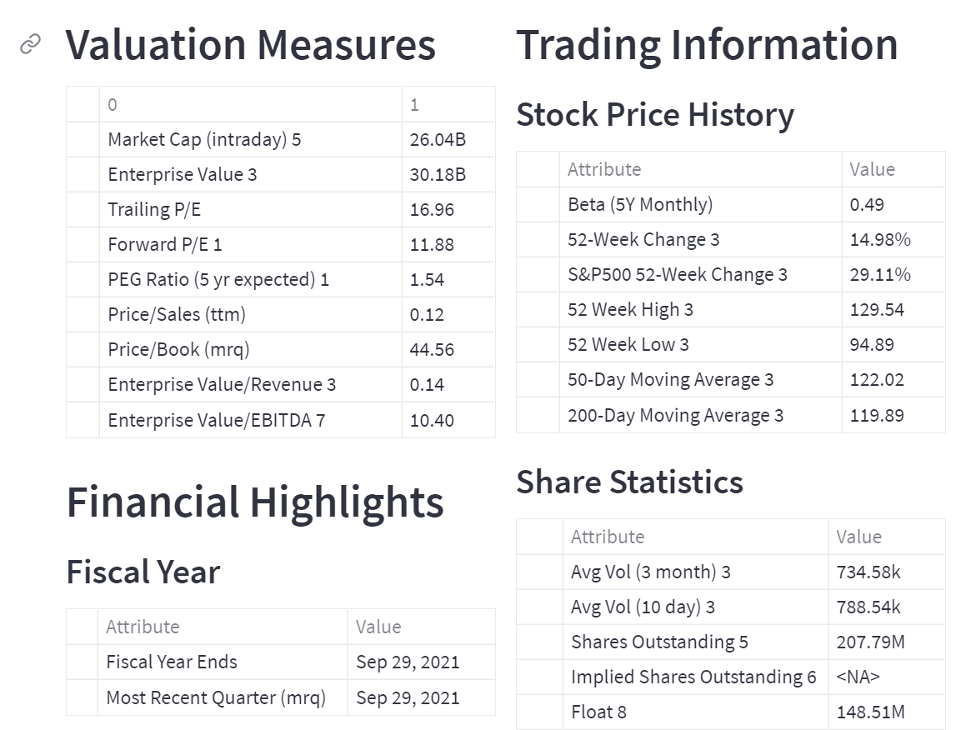
Tab3: Statistics
Tab that includes different data for a chosen ticker fetched with the use of get_stats_valuation and get_stats functions from Yahoo Finance.
Includes: Valuation Measures, Financial Highlights and Trading Information.

Slide 6
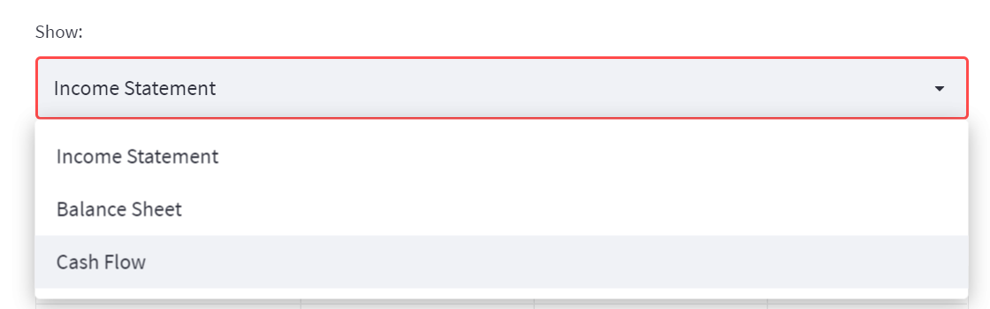
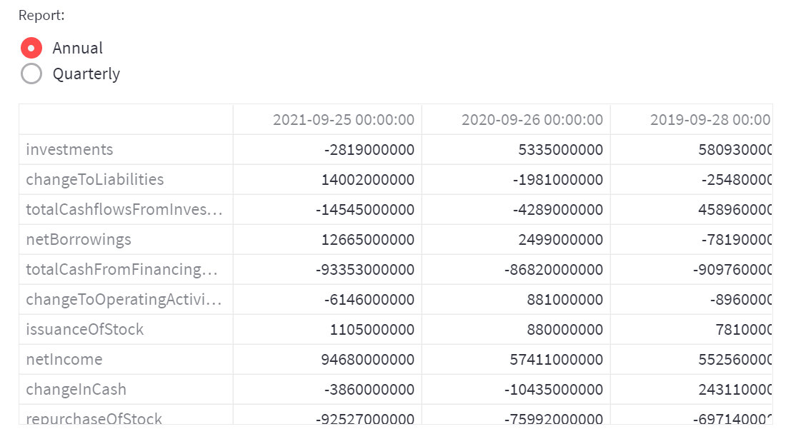
Tab4: Financials
Tab presents chosen financial statement for a selected ticker.
There is an option to switch between annual and quarterly financial statements.
Data is fetched from yahoo finance with get_income_statement, get_cash_flow and get_balance_sheet functions.

Slide 7
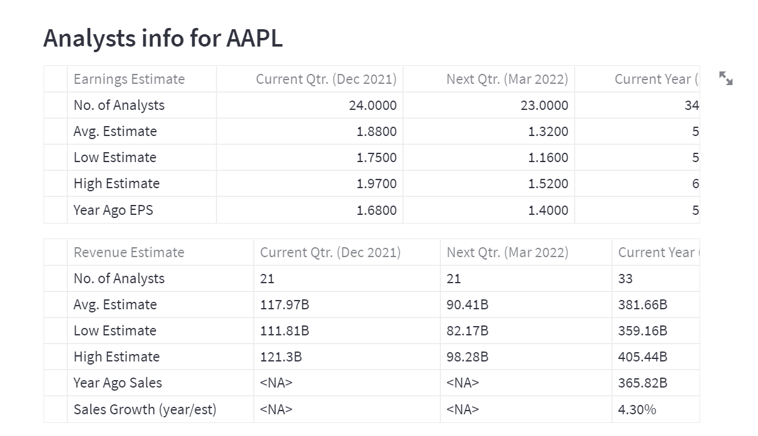
Tab5: Analysis
Analysts' info for the chosen ticker.
Includes: Earnings estimate, Revenue estimate, Earnings history, EPS trend, EPS revisions, Growth estimates.
Data fetched from yahoo finance using get_analysts_info function.

Slide 8
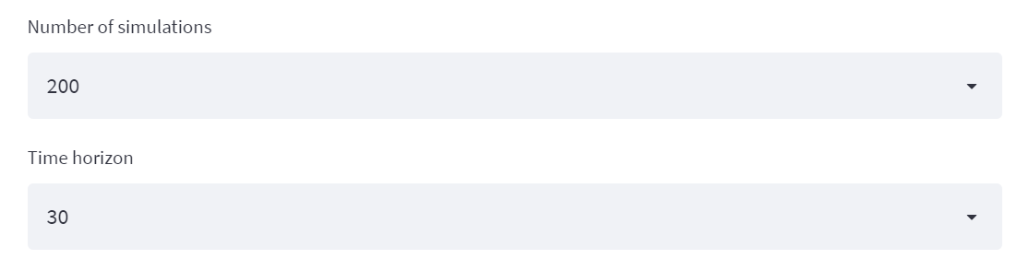
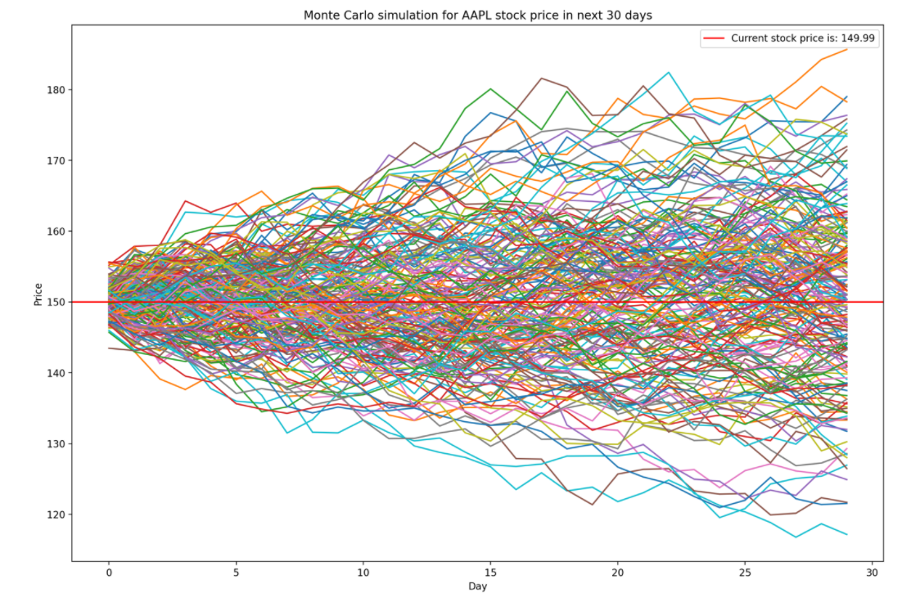
Tab6: Monte Carlo Simulation
Monte Carlo Simulation of a selected stock.
Number of simulations available for choice: 200, 500, 1000.
Time horizon for simulation: 30, 60 and 90 days.

Slide 9
References and inspirations
https://discuss.streamlit.io/t/streamlit-rerun/10701/2
https://github.com/streamlit/streamlit/issues/641
https://plotly.com/python/candlestick-charts/
https://stackoverflow.com/questions/5484922/secondary-axis-with-twinx-how-to-add-to-legend
https://stackoverflow.com/questions/46310711/show-only-first-and-last-ticks-label-of-x-axis-plot
https://www.geeksforgeeks.org/how-to-hide-axis-text-ticks-or-tick-labels-in-matplotlib/
https://stackoverflow.com/questions/36684013/extract-column-value-based-on-another-column-pandas-dataframe?rq=1
Streamlit, Matplotlib, YahooFinance documentations
Jupyter notebooks from class labs

